Slide 1
LOGISTIC REGRESSION
Dataset Utilized: Iris Flower Dataset
Presented By:
Malik Saad Ahmed

Slide 2
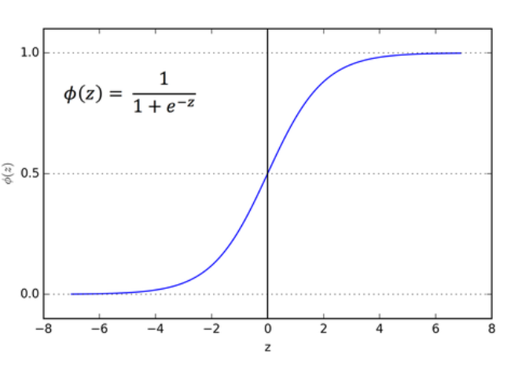
Logistic Regression:
A classification technique in Supervised Learning that performs binary
classification tasks by predicting probability of the outcomes and limits
the output to two states 1 or 0

Slide 3
Sigmoid Function:
The logistic regression classifies the input into two states using the logit function/sigmoid function as follows
Probability=1/1+e^{-y}
Logistic Regression algorithm helps us to classify these observations into two or more discrete classes.
Decision Boundary:
The outcome of this formula is always between 0 and 1.Probability more than 0.5 means the outcome will occur.
p ≥ 0.5 => class = 1
p < 0.5 => class = 0

Slide 4
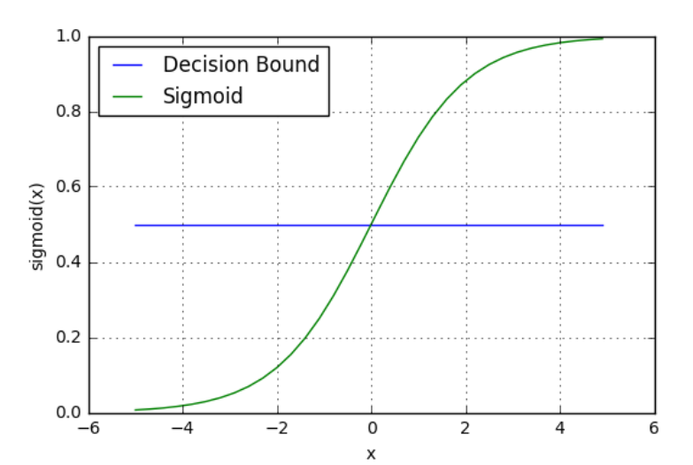

Slide 5
About the Dataset
Iris.csv is imported from Kaggle.com. It cantains 150 observed samples of Iris flowers. There are measured samples of length, width of sepals and petals
of 3 types of Iris flowers.
Libraries Used
Numpy : Python Library for Mathematical Operations
Pandas: Library for working with data analysis and manipulation
Matplotlib: Basic Data Visualization Library for making graphs
Seaborn: Advanced Data Visualization Library built on top of Matplotlib
Data Structures
Pandas DataFrame: A 2D matrix to store table data
Arrays and Lists: 1D arrays and lists for storing individual column data

Slide 6
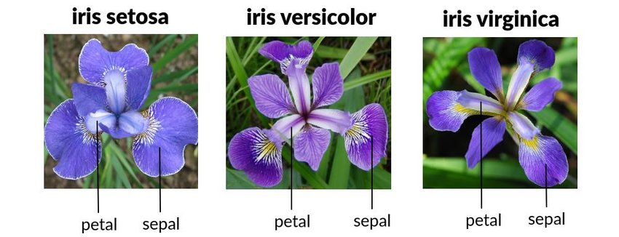

Slide 7
Shape of Dataset
The dataset contains 6 columns and 150 rows. The columns were Id, SepalLengthCm, SepalWidthCm, PetalLengthCm, PetalWidthCm, Species. Category column is later added for classification
Data Preprocessing
1) There were no empty cells in any columns
2) No duplicates values were found
3) The Id column was dropped as it not useful for logistic Regression
4) We give 70% data to the train sets and 30% to the test sets.
5) The model is being trained to differentiate whether a flower is versicolor
or not.

Slide 8
Calculations
The difference between the predicted probabilities and the true labels is called loss.
The cost or loss function is used to decrease loss which is computed using the formulae
Cost = -1/m ∑ [y*log(h) + (1-y)*log(1-h)]
where
m = length of target data
y= target data
h= sigmoid of dot product of features and an array of 0s.
The gradiant descent, an iterative algorithm is used to minimize the value of cost. Lower the cost, greater the accuracy of the algorithm.
Gradiant Descent = (x​^{T} * (h−y))/m
Theta-= rate*gradiant descent
h=sigmoid of z
The best practice is to increase the no of iterations and minimize the learning rate

Slide 9
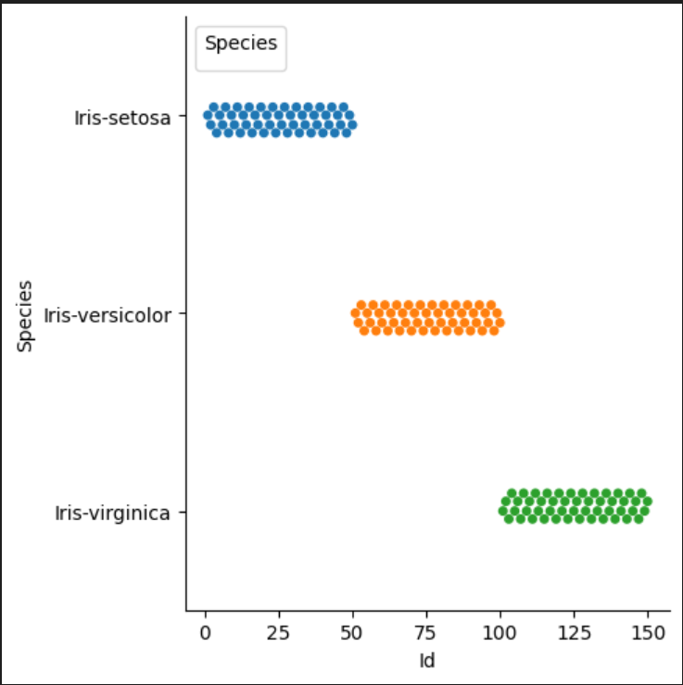
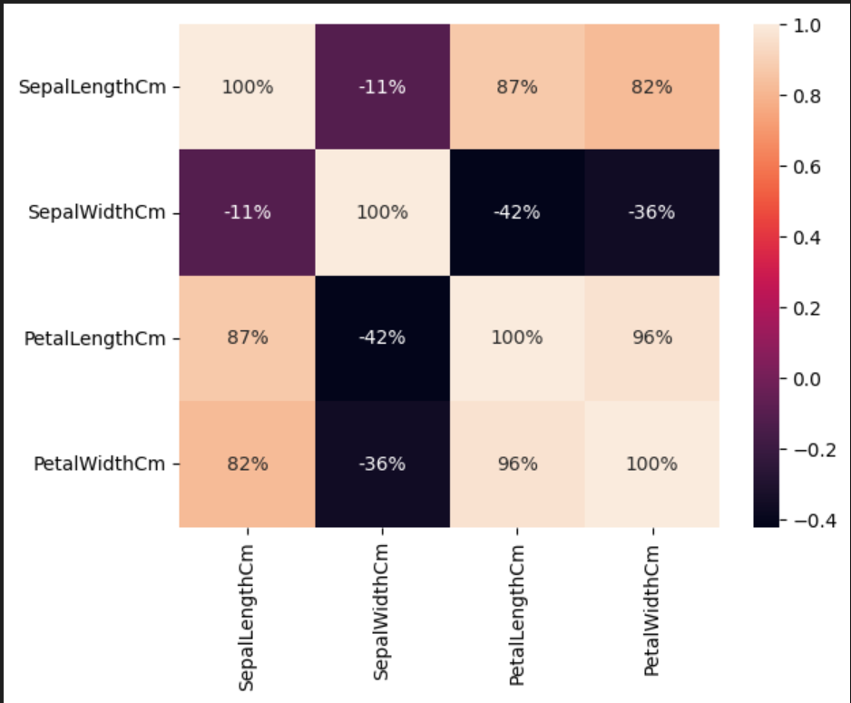
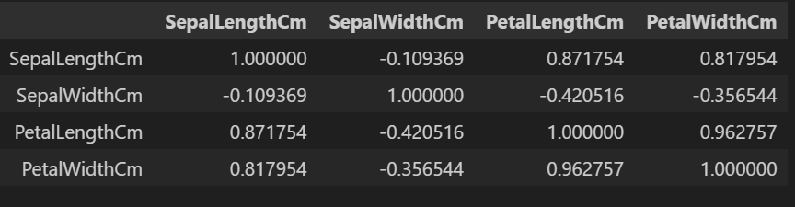
Data Visualization
Correlation

Slide 10
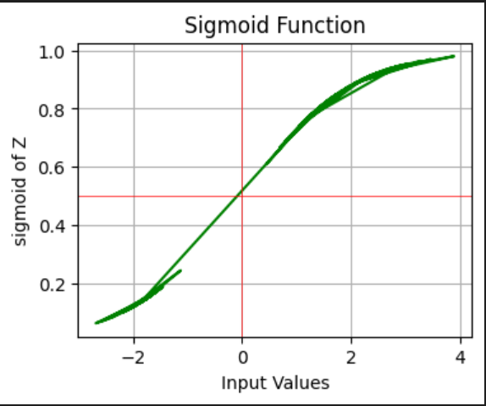
Results
Rate of learning was set at 0.005 and no of iterations was 1000. The final cost estimated was 0.31 after 1000th iteration.
The accuracy of the predicted values after inserting the X test set ranged from 89% to 92%.
Almost all the test data was categorized as 1 i.e it was categorized as Iris-versicolor

Slide 11


